Slide 1



Rich Bradley Data Analytics Portfolio https://www.linkedin.com/in/rich-bradley-mba/

Slide 2








Table of Contents GameCo Market Analysis Preparing for Influenza Flu Season RockBuster Data Analysis InstaCart Grocery Basket Analysis Flight Delay Project Analysis

Slide 3

Project 1 - GameCo
Data Set
Key Questions
Tasks
Total number of units of games sold between 1980 to 2016.
Numbers represent units sold in millions.
Regions North America, Japan, and Europe.
Different platforms, genres, and publishers.
Data Excel file.
Source: VGChartz
Are certain games more popular than others?
Any games increase/decrease in popularity?
How have the sales figures varied between geographic regions over time?
Cleaning and formatting data.
Build pivot tables.
Grouping the data
Conduct descriptive analysis and develop visual insights

Slide 4

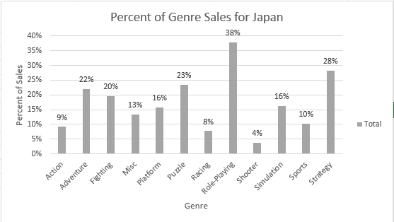
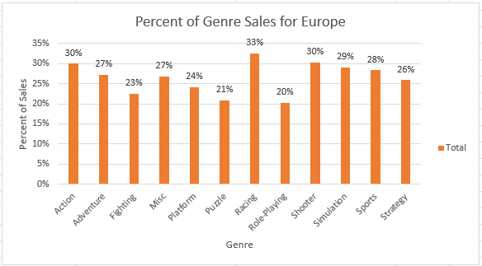
GameCo
Role Playing games are the highest sales at 38% in Japan, while Shooter games are the least with 4% in sales..
Racing games account for 33% in sales for Europe and Role-Playing games are 20% of sales.

Slide 5
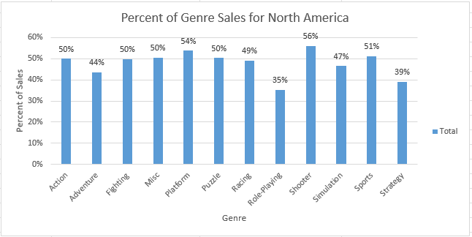
GameCo
Shooter games is 56% of North America sales and Strategy games are the least with 39% in sales.

Slide 6
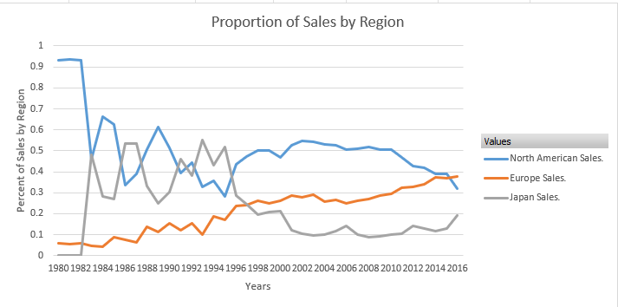
GameCo
The proportion of sales by region between 1980 to 2016 indicates the geographic regions sales expectations vary annually.

Slide 7
GameCo
Recommendations
Based on the data GameCo should focus on the top selling games for each region, which are:
Best selling games for North America are Shooter, Platform, and Sports.
Best selling games for Europe are Racing, Action, and Shooter.
Best selling games for Japan are Role Playing, Strategy, and Puzzle.
Additional research is needed to understand why sales for each of the regions have declined since 2010.
Redistribute marketing budget to Europe, since they have steady increasing sales and focus on their best-selling games.
Research into why Europe’s sales have been steadily increasing and see if a correlation can be made to help increase sales in North America and Japan.

Slide 8

Project 2 - Preparing for Influenza Flu Season
Objective
Key Questions
Tasks
Provide information to support staffing plan of medical personnel throughout the United States.
Prioritize states with vulnerable populations.
Assess data limitations that may prevent conducting desired analysis.
Source: CDC, US Census Bureau, Influenza Visits Data Set,
Who is affected by the flu?
Does age make a difference?
Which state need additional resources?
Which months are the highest for the flu?
Cleaning, formatting, address missing data.
Integrate at least two relevant data sets from different sources.
Find relationship between variables with at least one correlation.
Links: https://www.youtube.com/watch?v=ht2oeFXsBWE
https://public.tableau.com/app/profile/rich.bradley/viz/2_9Storytellingdashboard2/Story1?publish

Slide 9
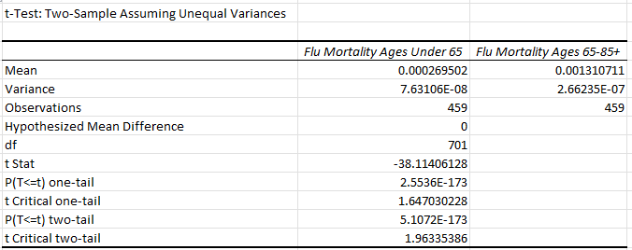
Preparing for Influenza Flu Season
The statistical hypothesis being tested are:
The influenza death rates for people age 65+ is less than or equal to the influenza death rates for people under age 65.
The influenza deaths for people ages 65+ is greater than the influenza death rates for people under age 65.

Slide 10
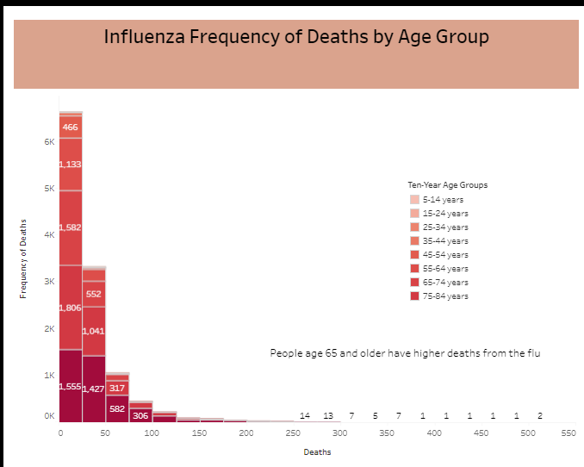
Preparing for Influenza Flu Season

Slide 11
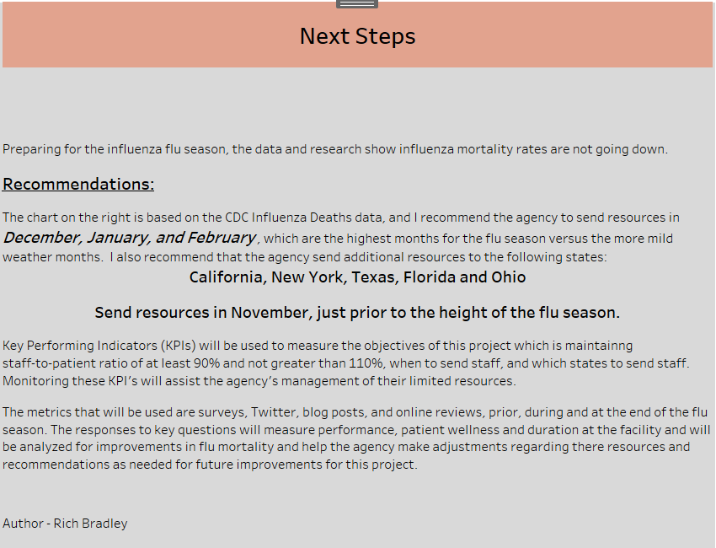
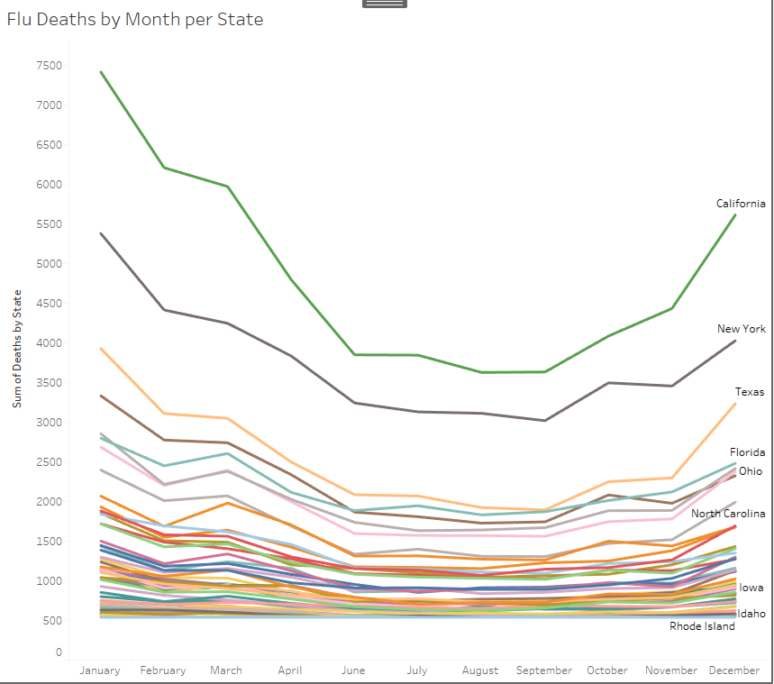
Preparing for Influenza Flu Season

Slide 12

Project 3 - Rockbuster Data Analysis
Data Set
Key Questions
Tasks
Rockbuster Stealth LLC a movie rental company plans to launch online video rental service to stay competitive.
Rockbuster’s film inventory, customers, payments etc.
Source: Rockbuster data set
What are the key KPI statistics?
Which countries are Rockbuster customers based in?
Where are the customers with high value based?
Create a data dictionary
Use SQL to create queries, subqueries and CTE’s.
Use Tableau to create visualization.
Links: https://public.tableau.com/app/profile/rich.bradley/viz/3_10Step1_final/top10countries?publish=yes
https://public.tableau.com/app/profile/rich.bradley/viz/5_8RockBustertop5customers/Top5Customers?publish=yes
https://github.com/Rich-Brad/sql-rockbuster-movie-rental

Slide 13
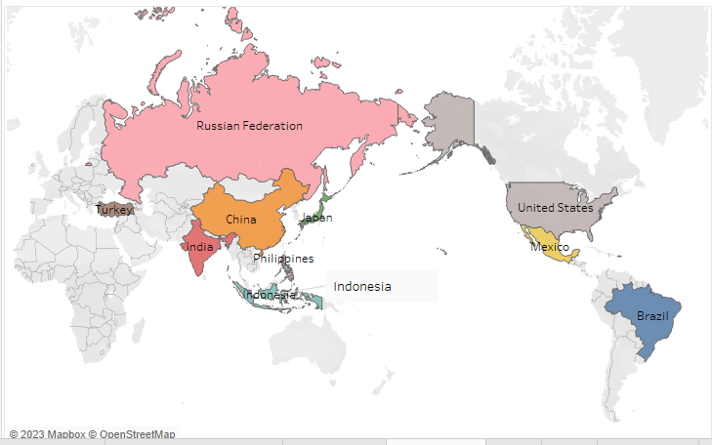
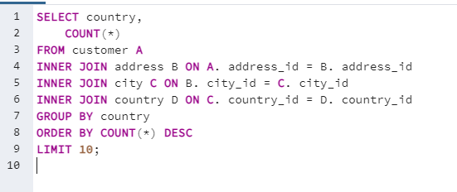
RockBuster Data Analysis
The Top Ten Countries Brand Focus

Slide 14
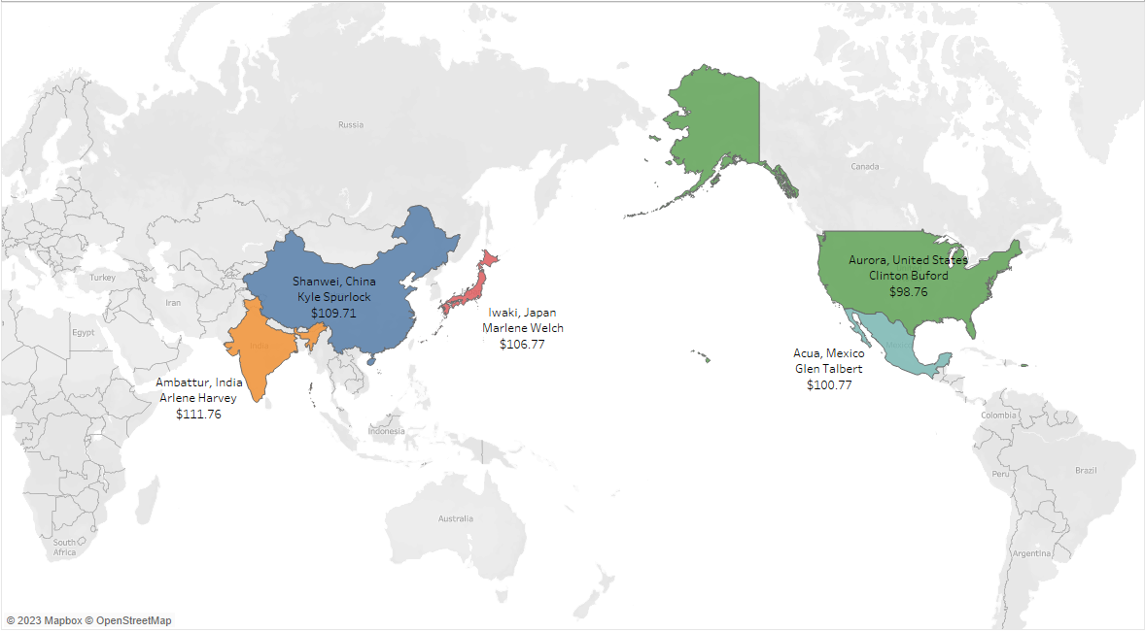
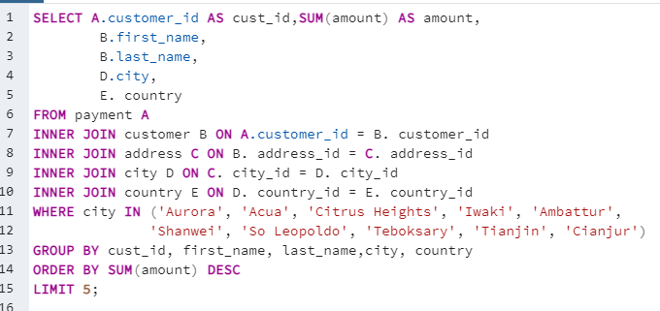
RockBuster Data Analysis
The Top Five Customers Based on Sales

Slide 15
RockBuster Data Analysis
RockBuster Recommendations
Rockbuster should leverage the top five customers in their marketing and image branding efforts to increase market share in the top ten countries and top cities.
In addition, Rockbuster, through their marketing and image branding can show they are a global company. This could help market expansion for future projects.
Finally, Rockbuster will need to continue testing and analyzing research results to better understand how to improve and build on their marketing and image branding in the top ten countries and cities.

Slide 16

Project 4 - Instacart Grocery Basket Analysis
Objective
Key Questions
Tasks
Online grocery store that operates through an app.
Want to uncover information about their sales patterns.
They want to target different customers with applicable marketing campaigns.
Source: “The Instacart Online Grocery Shopping Dataset 2017”, Accessed from www.instacart.com/datasets/grocery-shopping-2017 via Kaggle on 7/1/2023.
What is the busiest hours of the day?
What is the busiest day of the week?
What is the frequency of customers returning to Instacart?
What is the age and income of the customers?
Consistency check for missing values, duplication, and fix any mixed-type variables.
Used Python libraries and Jupyter to wraggle grouping and aggregating data.
Created visualizations with Python.
Links:
https://github.com/Rich-Brad/python-instacart-analysis

Slide 17
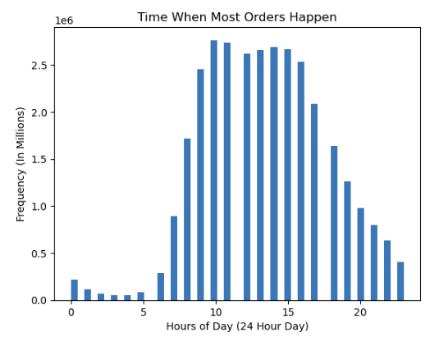
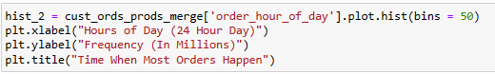
Instacart Grocery Basket Analysis
This histogram shows the bulk of orders happen between 8am to 4pm.

Slide 18
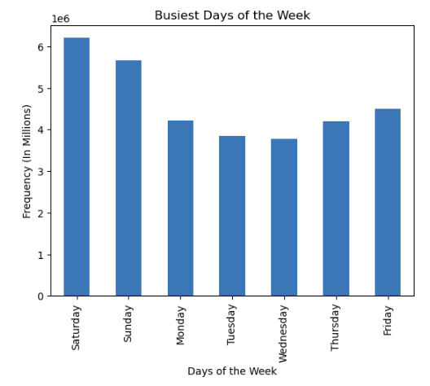
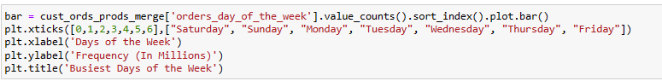
Instacart Grocery Basket Analysis
The busiest day of the week is Saturday with Tuesday and Wednesday being the least busy days.

Slide 19
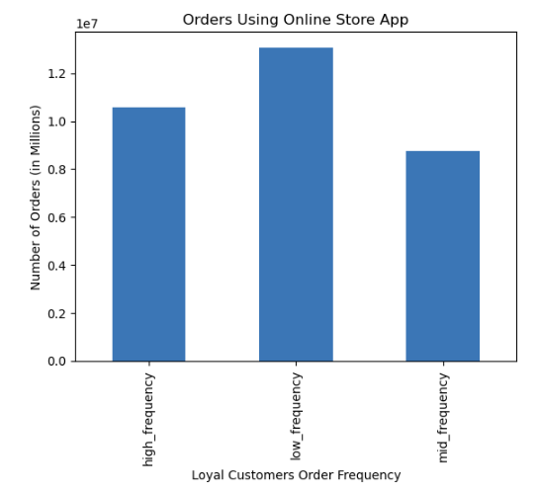
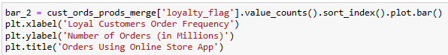
Instacart Grocery Basket Analysis
Customer loyalty by frequent use of the app.

Slide 20
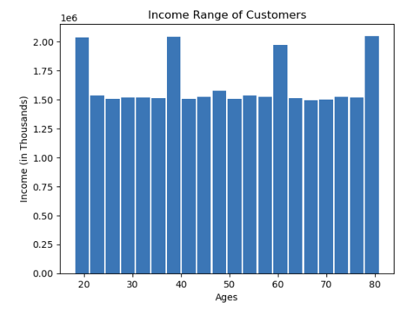
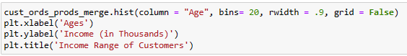
Instacart Grocery Basket Analysis
This histogram shows most incomes are about 200,000 and below in the different age groups.
With the highest concentration of incomes at 150,000.

Slide 21
Instacart Grocery Basket Analysis
Recommendations
The least busy days are Tuesday and Wednesday. Knowing this the marketing team can provide incentives or promotions to increase sales on those slower days.
The fewest orders happen between 11pm and 6am. The marketing team could do a midnight special or early bird shopping special to encourage more sales during these hours.
Have the marketing and sales team use incentives, for example, coupons or discounts to help increase customer use of the online app more and decrease the non-frequent customers to becoming regular or frequent customers.
Find ways to reward the loyal customers and incentivize the new customers with specials based on their purchases.

Slide 22
Project 5 - Flight Delay Project Analysis
Objective
Key Questions
Tasks
Determine the flight delays greater than 15 minutes
Which airlines are impacted the most
Provide information and insight regarding flight delays throughout the United States.
Want to uncover which airports and airlines have the greatest delays.
Access which delays, if any, have a correlation.
Source: Open Source: Kaggle.com
Original Author Eugeniy Osetrov (Owner)
Time Series Analysis Data.gov Pubisher opendata.Maryland.gov
Maintainer Christine Howard
Is there a connection between certain airlines and airports that show a higher delay rate within the data set?
What airline has the worse delays, greater than 15 minutes?
Are there certain airlines that are consistently having higher delays than other airlines?
Are there certain airports that are consistently having higher delays than other airports?
Consistency check for missing values, duplication, and fix any mixed-type variables.
Used Python libraries and Jupyter to wraggle grouping and aggregating data.
Created visualizations with Python.
Create a data dashboard with Tableau.
Links:
https://github.com/Rich-Brad/Airline-Delays.git

Slide 23
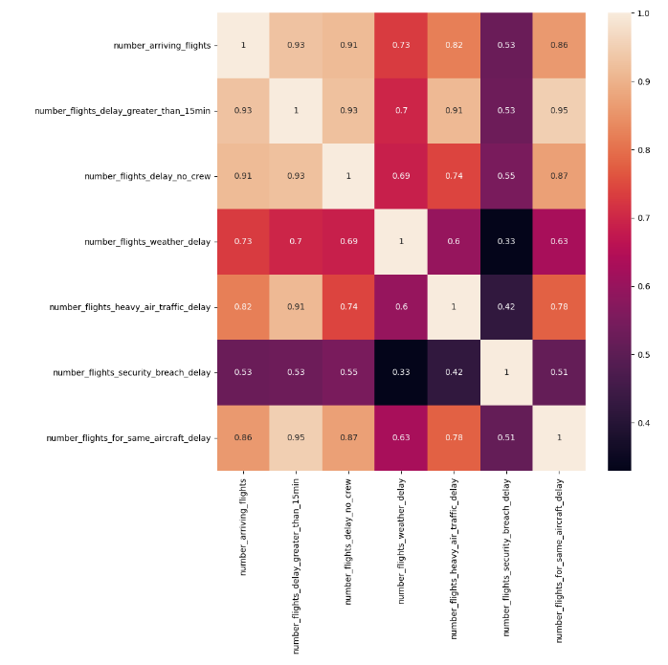
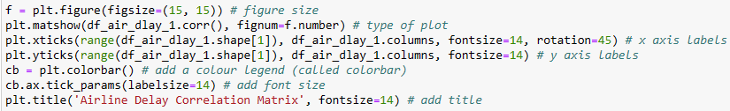
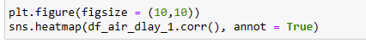
Flight Delay Correlation Matrix
This heatmap shows the correlation of the different delay categories and how strong or weak the correlations are in relationship to each delay.
The coefficient range between .3 - .5, the darker purple colors show a weak relationship.
The coefficient range between .5 – .7 the purple to red colors shows a moderate relationship.
The coefficient range between .7 – 1.0, the darker beige to light beige colors shows a strong relationship between the variables.

Slide 24
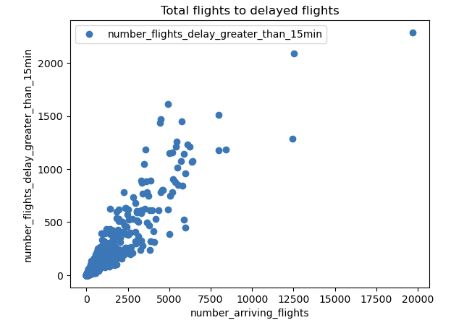
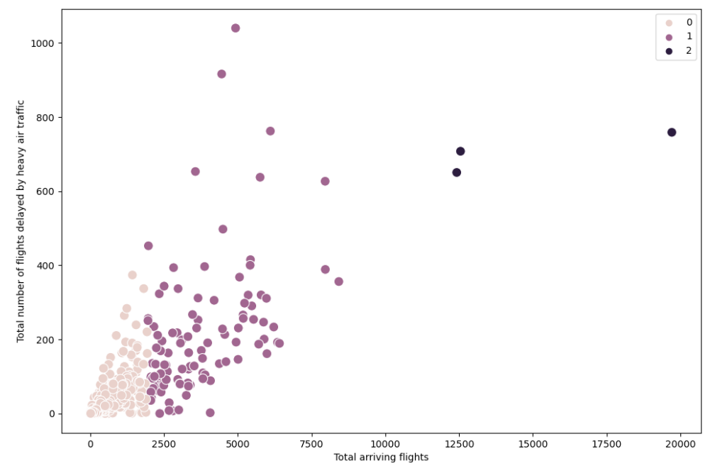
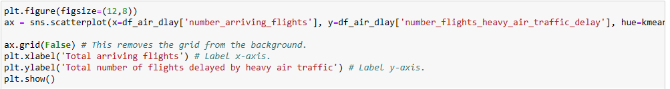
Flight Delay Normalization and Scatterplots

Slide 25
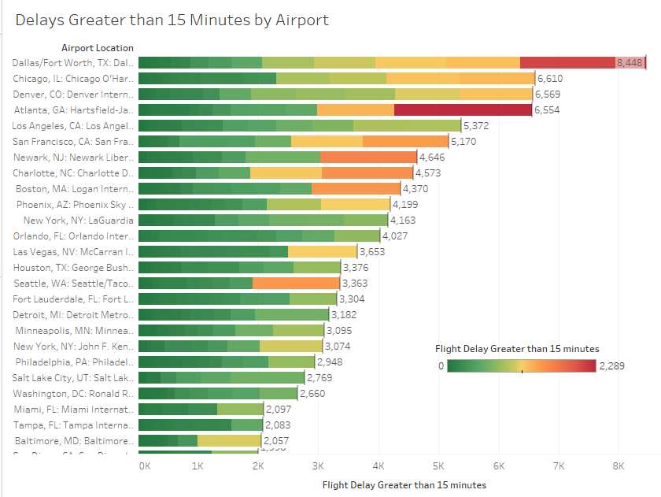
Flight Delays By Airport
Hypothesis
“If arriving flights encounter delays, then the number of arriving flight delays will be 15 minutes or longer”
Project Question
“Of the flight delays greater than 15 minutes, flights for the same aircraft, heavy air traffic, and weather delays, which has the most impact”?

Slide 26
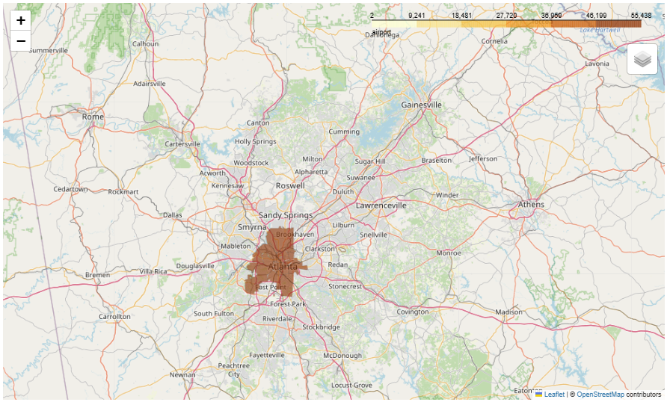
Flight Delay Choropleth Map of US Airports
This analysis shows the cities where the airports are located.
In this analysis Atlanta has the most with 55,438 arriving flights.

Slide 27
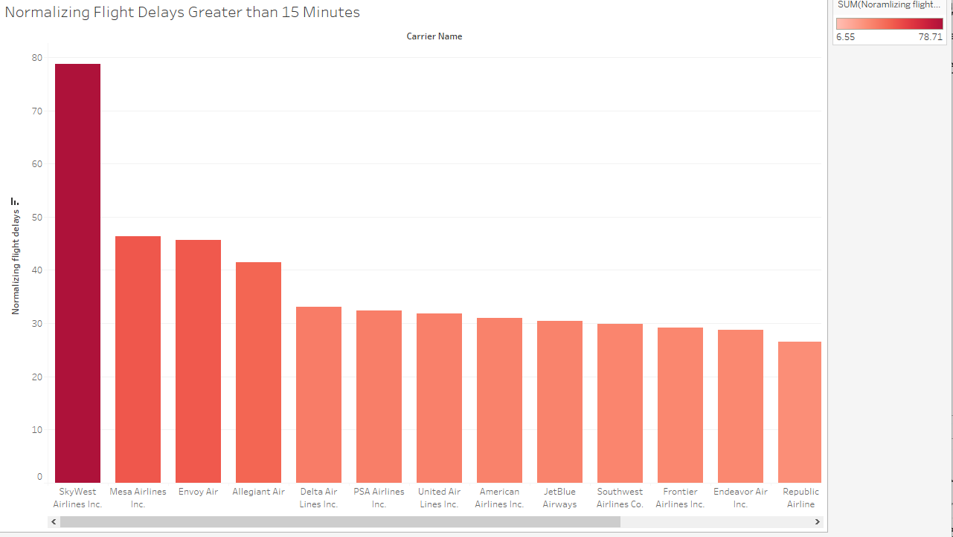
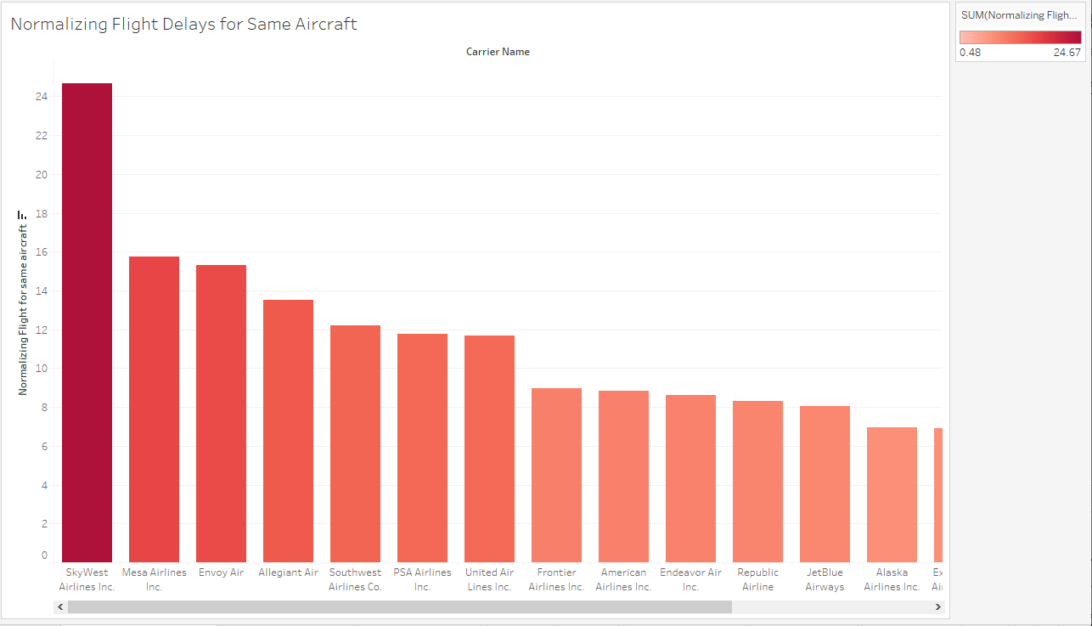
Flight Delay Airlines Affected By Delays
SkyWest Airlines Inc. is affected most with delays 15 minutes and greater. Followed by Mesa Airlines Inc. and Envoy Air.
SkyWest Airlines Inc. is most affected by flight delays for same aircraft. Followed by Mesa Airlines Inc. and Envoy Air.

Slide 28
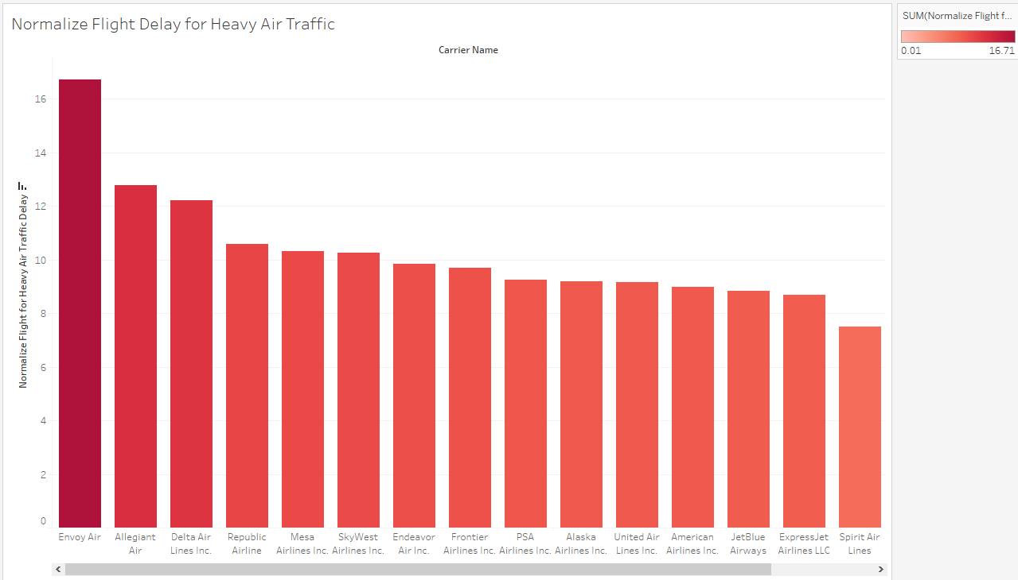
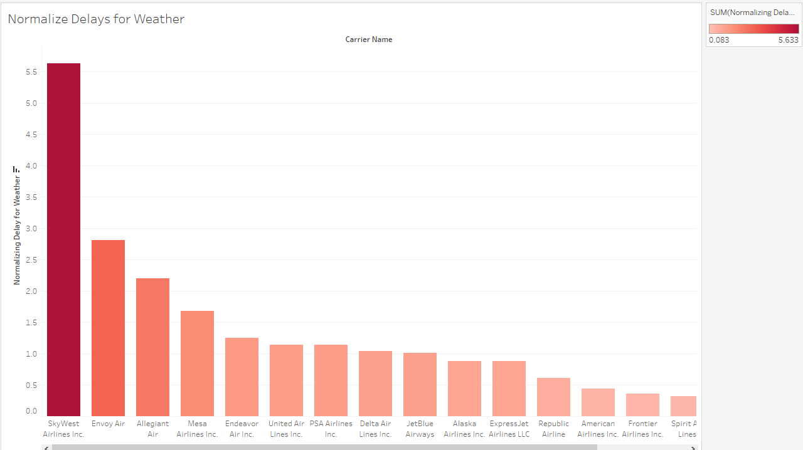
Flight Delay Airlines Affected By Delays
Envoy Air is most affect by heavy air traffic. Followed by Allegiant air and Republic Airline.
SkyWest Airlines Inc is most affected by weather delays. Followed by Envoy Air and Allegiant Air.

Slide 29
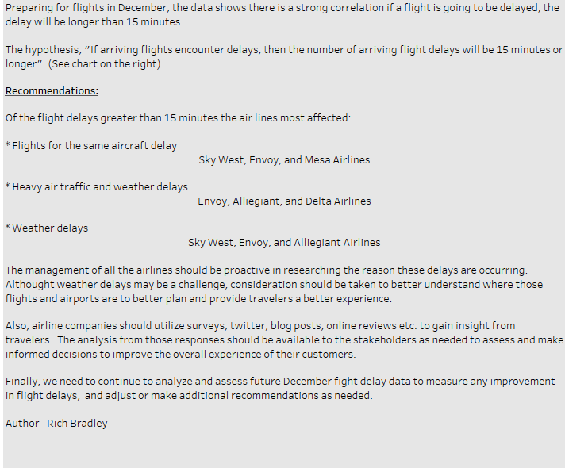
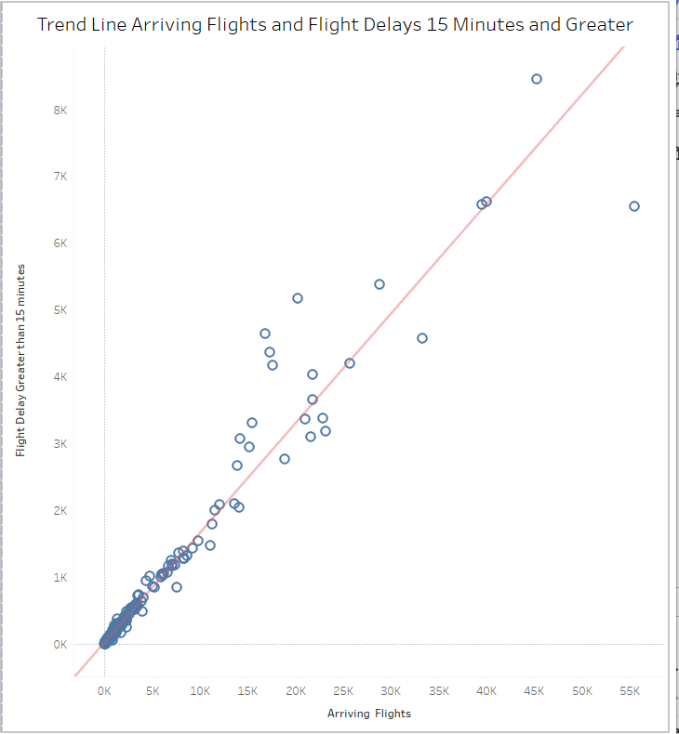
Recommendations and Next steps

Slide 30
Sources: Open Source: Kaggle.com Original Author Eugeniy Osetrov (Owner) Time Series Analysis Data.gov Pubisher opendata.Maryland.gov Maintainer Christine Howard

Slide 31
Links: https://www.youtube.com/watch?v=ht2oeFXsBWE https://public.tableau.com/app/profile/rich.bradley/viz/2_9Storytellingdashboard2/Story1?publish https://public.tableau.com/app/profile/rich.bradley/viz/3_10Step1_final/top10countries?publish=yes https://public.tableau.com/app/profile/rich.bradley/viz/5_8RockBustertop5customers/Top5Customers?publish=yes https://github.com/Rich-Brad/sql-rockbuster-movie-rental https://github.com/Rich-Brad/python-instacart-analysis https://github.com/Rich-Brad/Airline-Delays.git https://public.tableau.com/app/profile/rich.bradley/viz/Ex6_7A/AirlineFlightDelays?publish=yes https://www.kaggle.com/datasets/eugeniyosetrov/airline-delays/data https://catalog.data.gov/dataset/mva-vehicle-sales-counts-by-month-for-calendar-year-2002-2020-up-to-october

Slide 32
Rich Bradley Conclusion Slide Data Analytics Case Studies Contact me with any questions, or if you would like to collaborate with me at rbbrad@gmail.com

